Slide 1
Decision Diagrams in Combinatorics
Andrew Conway
Conference in honor of Tony Guttman’s 80th birthday

Slide 2
Talk Contents
What is a binary decision diagram (BDD)?
  How is it useful in combinatorics?
  How about a other variants?
Use in pattern avoiding permutations
  Generalization to multiset – MBDD, MZDD, etc.
  Paper with Tony:
    “Counting Occurrences of Patterns in Permutations”
      January 2025 The Electronic Journal of Combinatorics 32(1)
      DOI:10.37236/12963

Slide 3
What is a decision diagram?
A data structure
Represents a binary function
  e.g. f(a,b,c) = (a xor b) and (not c)
The Art of Computer Programming, Volume 4, Fascicle 1,
Bitwise Tricks & Techniques; Binary Decision Diagrams
                Donald Knuth

Slide 4
Combinatorics motivation
A binary function can be considered to define a set S = {x:f(x)=true}
e.g. variables are bonds on a fixed size lattice, function is true if they form a self avoiding walk.
Number of true elements = number of self avoiding walks.

Slide 5
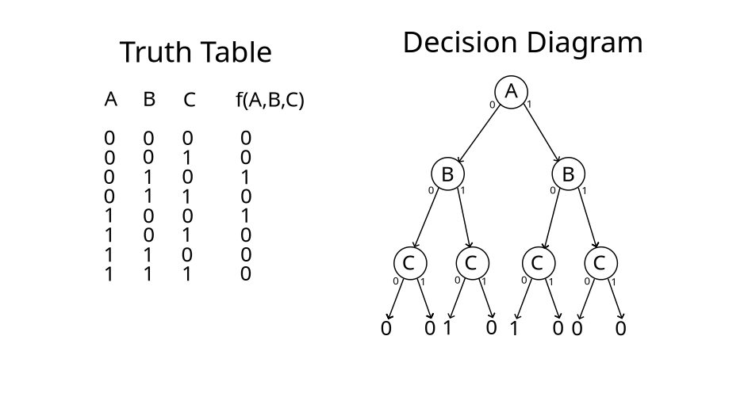

Slide 6
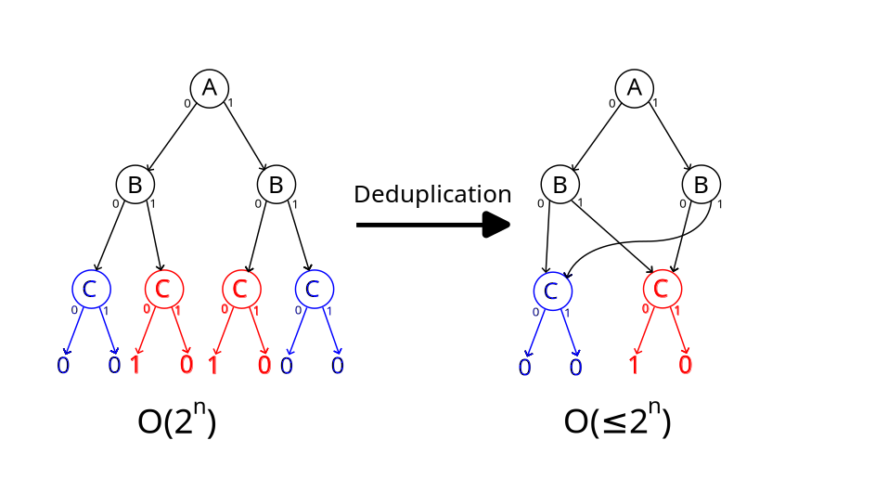
MOST IMPORTANT SLIDE OF THE TALK

Slide 7
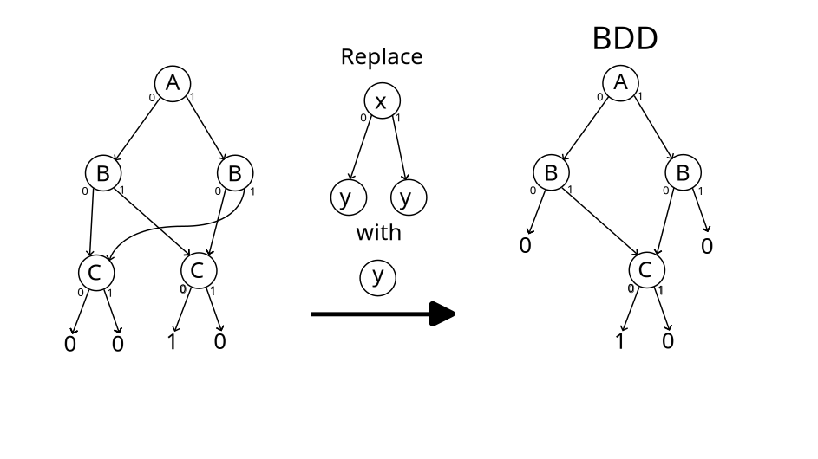

Slide 8
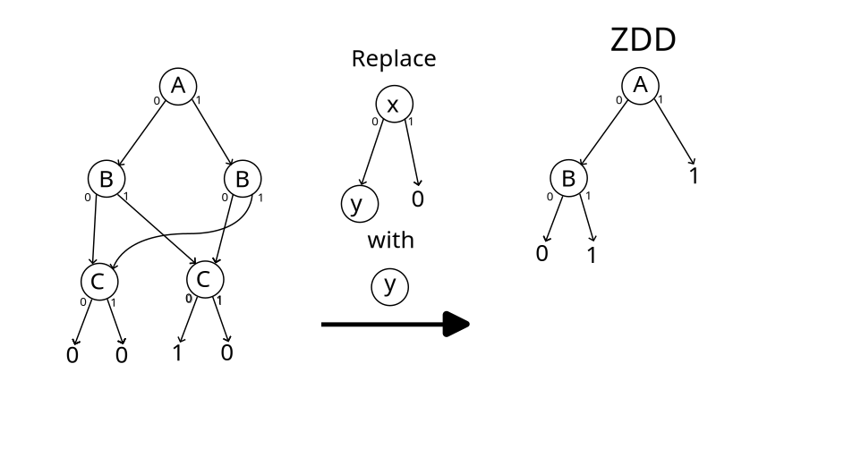
Not what it naively looks like!

Slide 9
What can you do with an xDD?
Often store a complex function of n variables in much less space than O(2^{n}).
Logical operations (and or not) of sizes s and t take worst case O(st) and often much better
Fast to count, find smallest number of satisfying elements, get an arbitrary solution

Slide 10
Application : SAWs
Self avoiding walk on a finite rectangular lattice
Each bond is a variable
Function is true if it is a SAW
Same algorithm as to count them, just with a more complex answer than an integer.

Slide 11


Application : Tilings
Knuth suggest the problem of tiling a chessboard with dominoes – how many ways?
1 of 12988816 5134724 of 12988816

Slide 12
Speed
BDD: 2.1 ms 5679 nodes (11712 to generate)
  41 lines of code including comments, not counting xDD library
ZDD: 3.2 ms 2298 nodes (19790 to generate)
Simple dynamic programming approach: 6 µs
  27 lines of code including comments
Program: https://github.com/AndrewConway/xdd

Slide 13

Bigger problem
Tiling with unimoes, dominoes, trionimoes:
92109458286284989468604
243057372832 fewest tiles
BDD: 1.4s, 2,447,347 nodes
ZDD: 1.7s, 512,225 nodes

Slide 14

Application : Directed animals
Polyonimoes on a square lattice.
  Each occupied site other than the root has to have an element directly below or to the left
  One variable for each site on a sufficiently large lattice.
  All constraints are local (suits xDD).
root

Slide 15
Performance
20 terms. 86,574,831 animals
BDD : 7.8s
  2,191,868 nodes 23,292,361 used
ZDD : 6.2s
  1,292,942 nodes 13,952,387 used
Dynamic programming :228µs
  5022 cache elements

Slide 16
Not looking great for xDDs.
Simple program much faster for counting.
xDDs make it easier to make pictures. Possibly more straight forward?

Slide 17
Pattern Avoiding Permutations
Let p be a permutation of 1..n
Let P be a permutation of 1..m m≤n
p contains the pattern P if a subset of p of length m has the same relative ordering as P.
  Otherwise p avoids the pattern P.
Examples:
  1,5,3,2,4 contains the pattern 1,3,2 as the subsequence 1,5,3 is in the same relative order as 1,3,2. (also 1,5,2 and 1,5,4 and 1,3,2)
  1,2,3,4,5 avoids the pattern 1,3,2 (also avoids 2,1)

Slide 18
Enumeration of pattern avoiding permutations : length 1 to 4
All but one class solved analytically.
Dedicated algorithms for enumeration of the 1324 class.

Slide 19
Enumeration of PAPs : length 5
Too many hard patterns for specialized algorithms
Best general algorithms explicitly generated all solutions, so slow

Slide 20
Permutation Decision Diagrams
Minato had a novel idea for representing a set of permutations
  Represent permutations by a set of binary variables
  Make a new operation on such ZDDs to compose permutations, maintaining canonicity.
  These are called πDDs.
Inoue improved the encoding, called Rot-πDDs.

Slide 21
Use of πDDs in PAPs
Minato defined a set of operations that created a set of all pattern containing permutations.
Then subtract from n! to get PAPs.
Much faster than direct enumeration.
Inoue’s variation is better still.

Slide 22
Pattern containing permutations
Next step : How many permutations contain a pattern exactly 1 time? Or r times?
For simple patterns, there are some analytic solutions.
More generally…?

Slide 23
Minato’s algorithm and multisets
Take Minato’s algorithm for generating all pattern containing permutations
Use multisets instead of sets.
  Where {a,b,b,c}×{b,b,c} = {b,b,b,b,c}
Now the multiplicity of each element is the number of times it contains the pattern.

Slide 24
Multisets and decision diagrams
Decision diagrams can be extended to represent multisets.
  f(booleans) →ℕ
Modification: instead of a reference to a node, have an integer multiple and a reference to a node.

Slide 25
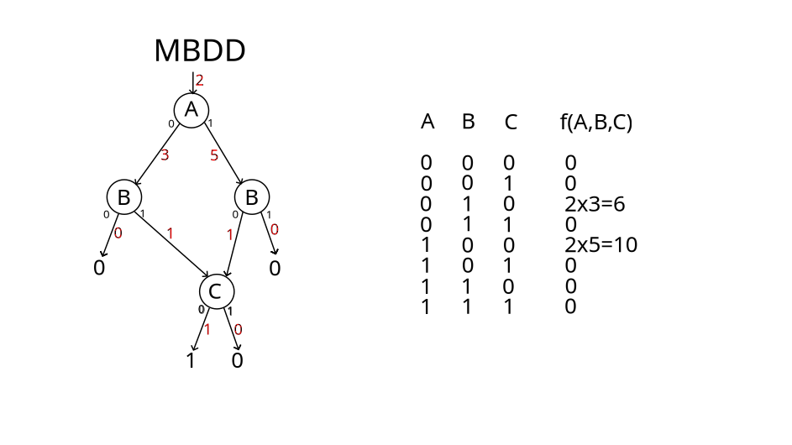

Slide 26
Canonicalization
Need to have a unique representation for each multiset.
  A multiple of 0 iff the reference is to 0.
  Each node has two references. Their multiples should be coprime (or 1 if the other is 0).
Details and theory in section 2 of:
    “Counting Occurrences of Patterns in Permutations”
      January 2025 The Electronic Journal of Combinatorics 32(1)
      DOI:10.37236/12963

Slide 27
Implementation
Rust library at https://github.com/AndrewConway/xdd
Can enumerate by multiplicity efficiently.
Multiset BDD is an MBDD.
  Similarly MZDD, MπDD,Rot-MπDD
Program used in paper is in that as an example.

Slide 28
References
Theory and results
    “Counting Occurrences of Patterns in Permutations”
      January 2025 The Electronic Journal of Combinatorics 32(1)
      DOI:10.37236/12963
Library and program
  https://github.com/AndrewConway/xdd
Program to make pictures & benchmarks in this talk
  https://github.com/AndrewConway/xdd_pictures

